Slide 1
Review of Lecture on 28 Aug 2013 Chapter 4 Series
(A)Infinite sum (series)
Infinite sum exists (series converges) if
(B) Geometric series (GP)

Slide 2




(C) Some interesting series

Slide 3
(D) Another Important Series
p-series
diverges 0 ≤ p ≤ 1
converges p > 1

Slide 4
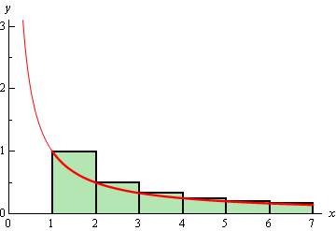
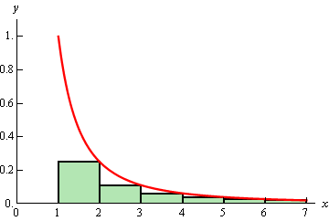
Idea of the proof

Slide 5
To find the exact value of a given series is not easy.
However “whether the given series
is convergent or not” is important.
Often, we can determine that a series converges
without knowing the exact value to which it converges.
There are several methods checking the convergence of a series .
However , in this module, we only study one method, ratio test. This test can be applied to many series. But Not all series can be tested by ratio test, we need other tests, which we do not study here.

Slide 6
(G) Ratio Test
Then converges if ρ < 1
the series
diverges if ρ > 1
No conclusion can be drawn if ρ = 1

Slide 7
(G) Finding limit in the ratio test

